Slide 1
Ongoing development
AGO 18, 2024
Renato poli

Slide 2
Status
Biot homogenization paper (under review)
Results in multiphase flow (ok)
Proposal draft (October)
Side work: IT stuff

Slide 3
BIOT HOMOGENIZATION
JUL 5, 2024
Renato poli

Slide 4
Biot homogenization paper
Draft ready
Espinoza is reading
Note : Infrastructure migration...

Slide 5
Side work: IT stuff
JUL 5, 2024
Renato poli

Slide 6
BOX DIRECTORY STRUCTURE AND GUIDELINES
STUDENT/
[yyyy]-[Student-Name]
DISSERTATION/
FINAL REPORT/
THESIS/
EVENT/
[yyyy]-[Event]-[Talk-Title]/
PAPER/
[yyyy]-[Journ/Conf Initials]-[Paper-Title]/
DATASET/
[Identification]/
CODE/
[Identification]/
PROJECT/
[yyyy]-[Identification]/
REPORT/
CODE/
DATASET/
PAPER/
...
Ideias
Each talk, paper etc must be in a directory with its supporting files.
The directory must contain:
Root directory:
Final documents: PDF, PPT, DOC
Nested directories:
Data files (Excel sheets, python etc)
Review processes files
Figures
Python scripts
Old versions
Regarding Code:
- Prefer to use a github repository.
- Checkout the latest version in CODE/ directory

Slide 7
Proposal draft
JUL 5, 2024
Renato poli

Slide 8
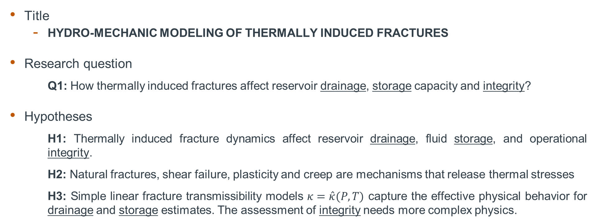
OVERVIEW
Title
HYDRO-MECHANIC MODELING OF THERMALLY INDUCED FRACTURES
Research question
Q1: How thermally induced fractures affect reservoir drainage, storage capacity and integrity?
Hypotheses
H1: Thermally induced fracture dynamics affect reservoir drainage, fluid storage, and operational integrity.
H2: Natural fractures, shear failure, plasticity and creep are mechanisms that release thermal stresses
H3: Simple linear fracture transmissibility models $κ=\hat{κ}(P,T)$ capture the effective physical behavior for drainage and storage estimates. The assessment of integrity needs more complex physics.

Slide 9
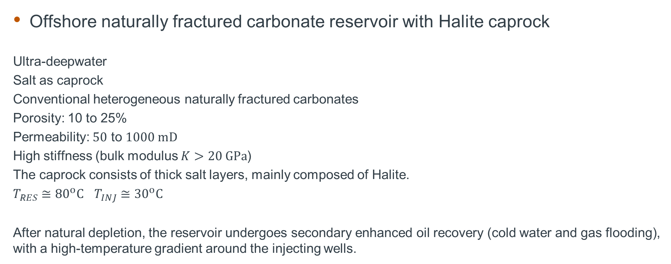
TARGET APPLICATION
Offshore naturally fractured carbonate reservoir with Halite caprock
Ultra-deepwater
Salt as caprock
Conventional heterogeneous naturally fractured carbonates
Porosity: 10 to 25%
Permeability: $50$ to $1000 mD$
High stiffness (bulk modulus $K>20 GPa$)
The caprock consists of thick salt layers, mainly composed of Halite.
$T_{RES}≅{80}^{o}C$ $T_{INJ}≅{30}^{o}C$
After natural depletion, the reservoir undergoes secondary enhanced oil recovery (cold water and gas flooding), with a high-temperature gradient around the injecting wells.

Slide 10
METHODOLOGY
IPACS (Wheeler’s) ... or ... PMF3D (my own) ... or ... Commercial
Physics
Thermal
Plasticity
Fracture Propagation (unknown path)
Creep
Numerics
Finite elements.
Phase-field?
Upscaling into Smeared models?
Immersed system – 2 meshes?

Slide 11
Step-by-step
Elastic ➔ ok!
Thermal
Stress analysis
Plasticity
Creep
Propagation

Slide 12

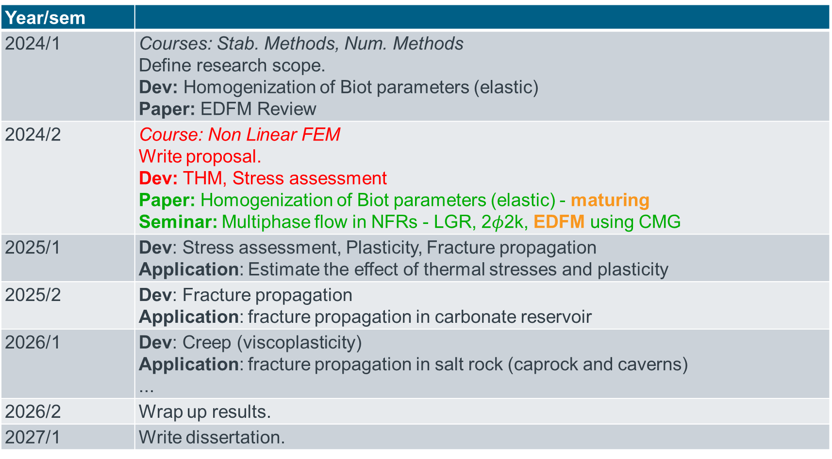
Year/sem
2024/1 | Courses: Stab. Methods, Num. Methods Define research scope. Dev: Homogenization of Biot parameters (elastic) Paper: EDFM Review
2024/2 | Course: Non Linear FEM Write proposal. Dev: THM, Stress assessment Paper: Homogenization of Biot parameters (elastic) - maturing Seminar: Multiphase flow in NFRs - LGR, 2$φ$2k, EDFM using CMG
2025/1 | Dev: Stress assessment, Plasticity, Fracture propagation Application: Estimate the effect of thermal stresses and plasticity
2025/2 | Dev: Fracture propagation Application: fracture propagation in carbonate reservoir
2026/1 | Dev: Creep (viscoplasticity) Application: fracture propagation in salt rock (caprock and caverns) ...
2026/2 | Wrap up results.
2027/1 | Write dissertation.

